Slide 1
Induction Session

Slide 2
Welcome & Introductions
Notes:
Section Header

Slide 3
Acknowledgement of Country
We acknowledge the traditional custodians of the land of the Kulin Nation who have walked upon and cared for this country for thousands of years. We pay our respect to them and their cultures and to Elders past, present and emerging.

Slide 4
Acknowledgement of Victims and Survivors
We acknowledge the pain and harm caused to the victims and survivors of child abuse in the Catholic Church.
“No words of apology – while always needed – will ever be enough to right the evil done to those who have been abused, and those who were not listened to and believed. Efforts to repair the harm done – while entirely necessary – cannot overcome the evil perpetrated upon innocent children and vulnerable adults, and the harm experienced by families and communities”.
Archbishop Peter A. Comensoli
Source: Royal Commission Into Institutional Responses to Child Abuse (2017) Message to Australia

Slide 5
Archbishop’s Message

Slide 6
Self-Care
This session may cover issues that could be uncomfortable, unsettling or distressing.
If it does bring up issues for you, we encourage you to reach out, seek help and speak to the people around you.
It is important that you seek support from either family, friends or other trusted people in your life such as your parish priest. You may even wish to reach out to a support service including:
Employee Assistance Program - 1800 81 87 28
Lifeline 13 11 14
Centre Against Sexual Assault 9635 3610

Slide 7
Context of Safeguarding
Notes:
Section Header

Slide 8
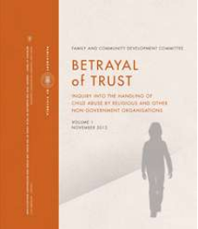
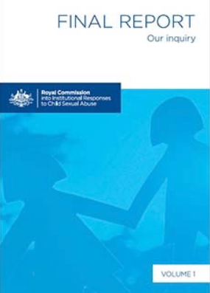
Why Is Safeguarding Important?
The Royal Commission Into Institutional Responses to Child Sexual Abuse and the Victorian Betrayal of Trust Inquiry focussed on exploring organisational safety for children and young people.
These inquires found that all types of organisations have been impacted by abuse e.g. sporting, youth, music/drama/dance, religious and non-religious, out of home care, early childhood, disability.
It highlighted the need to implement a set of standards for all organizations, in order to ensure children and young people’s safety.

Slide 9
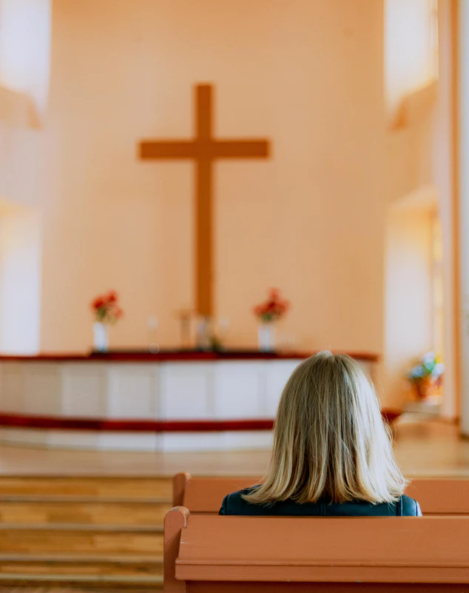
Why Is Safeguarding Important?
During the Royal Commission into Institutional Responses to Child Sexual Abuse 4,444 people reported abuse in the Catholic Church.
This represents 61.8% of all survivors who reported sexual abuse in a religious institution and 36.2% of all survivors.

Slide 10
Why Is Safeguarding Important?
The Royal Commission into Institutional Responses to Child Sexual Abuse also learnt that:
More than 50% of all survivors were aged between 10 and 14 years when they were first abused
4.3% of all had disability at the time of the abuse
14.3% of all survivors were Aboriginal or Torres Strait Islander
Average period of time for survivors to disclose was 23 years
Due to the stigma and guilt many survivors of child sexual abuse may experience, some never come forward to report their abuse, so figures are likely to be an underestimate of the abuse that occurred in the Catholic Church.

Slide 11
Safeguarding Children and Young People Framework

Slide 12
CAM Safeguarding Children and Young People Framework
CAM Safeguarding Children and Young People Policy
National Principals for Child Safe Organisations
AUSTRALIAN HUMAN RIGHTS COMMISSION
Australia
National Catholic Safeguarding Standards
AUSTRALIAN CATHOLIC STANDARDS LIMITED
Catholic Organisations in Australia
Child Safe Standards
Reportable Conduct Scheme
COMMISSION FOR CHILDREN AND YOUNG PEOPLE
Victoria

Slide 13
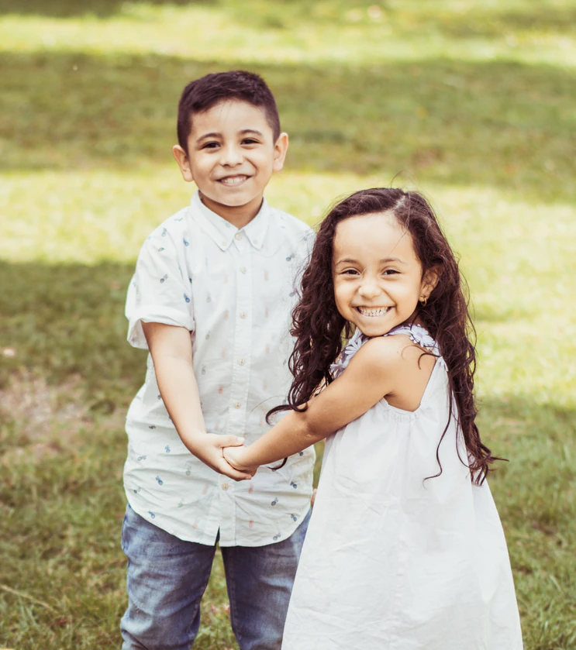
Building a Safeguarding Culture
A culture of safety within the parish ensures that children and young people (defined as a person under 18 years of age) can actively and fully participate in the life of the parish and realise their potential in a faith community. It includes:
Empowering children and young people by creating opportunities to involve them in decision-making about programs, activities and events that affect them. This can be a significant protective factor in preventing abuse within parishes.
Effective child safety within parishes cannot be undertaken without the involvement of parents and seeks to engage parents as critical partners in promoting the safety of children and young people.

Slide 14
Safeguarding Responsibilities
The Catholic Archdiocese of Melbourne holds the care, safety and wellbeing of children and young people as a fundamental responsibility of the Church. This commitment is drawn from, and central to, the teaching and mission of Jesus Christ, with love, justice and the dignity of each human person at the heart of the Gospel. Caring for and protecting others is at the heart of our values and mission.
Through safeguarding, parishes aim to prevent abuse occurring and reduce opportunities for it to occur.
Within the parish, safeguarding is EVERYBODY’S responsibility.

Slide 15
Safeguarding Responsibilities
Parish Priest and Parish Leadership | Safeguarding Committee | Other Clergy (Assistant Priests, Deacons etc.), Employees and Volunteers | Safeguarding Unit (CAM)
To ensure compliance with the Framework Supports the work of the Safeguarding Committee Works to create and foster a culture of safeguarding in the parish | Actively embed child safety within the parish Assisting the parish priest, with implementation of the requirements of Safeguarding Framework Work towards compliance with the requirements of the safeguarding framework (self-assessment tool) Serves as an advisory body | Moral, legal and ethical responsibility to care for, and promote the well-being of children and young people Compliance with parish Safeguarding Children and Young People Policy | Development of policy and resources Support and advice Coordinate responses to allegations of abuse or misconduct

Slide 16
The Role of the Safeguarding Committee
Safeguarding Committees work with the Parish Priest and parish leadership to ensure policies, processes and practices are in place to protect children and young people.
The Safeguarding Committee is an advisory committee only. Committee members are not subject to the legal obligations under the Child Wellbeing and Safety Act 2005 or the Child Safety Standards made under it. The legal obligation remains with the leadership of the parish, agency or entity e.g. the Archbishop or Parish Priest.
The Safeguarding Committee ensures that the safeguarding is embedded across the parish and compliance requirements are met by:
Promoting child safety within their community
Implementing, maintaining and reviewing safeguarding processes and procedures
Involving children, young people and their families in safeguarding
Ensuring that reporting processes for concerns and allegations are well communicated and acted upon

Slide 17
Safeguarding Children and Young People Policy
Sets out safeguarding responsibilities
Establishes behavioural expectations
Outlines policies, procedures and strategies to prevent child abuse and keep children and young people safe
Explains the processes for responding to and reporting child safety concerns or allegations of abuse

Slide 18
Code of Conduct and Declaration
Outlines the expected behaviours of all clergy, staff and volunteers in the Archdiocese
Covers:
Keeping children and young people safe from abuse and harm
Creating safe physical and online environments
Supporting cultural safety and inclusion
Promoting respectful relationships
Taking action to safeguard children and young people
The ongoing commitment of all clergy, staff and volunteers to the protection, wellbeing and safe participation of children and young people
The code of conduct along with role descriptions help to set clear boundaries for work within groups and ministries

Slide 19
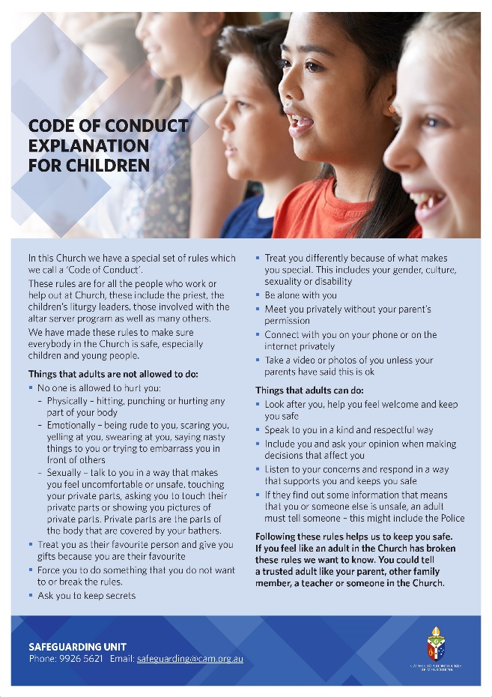
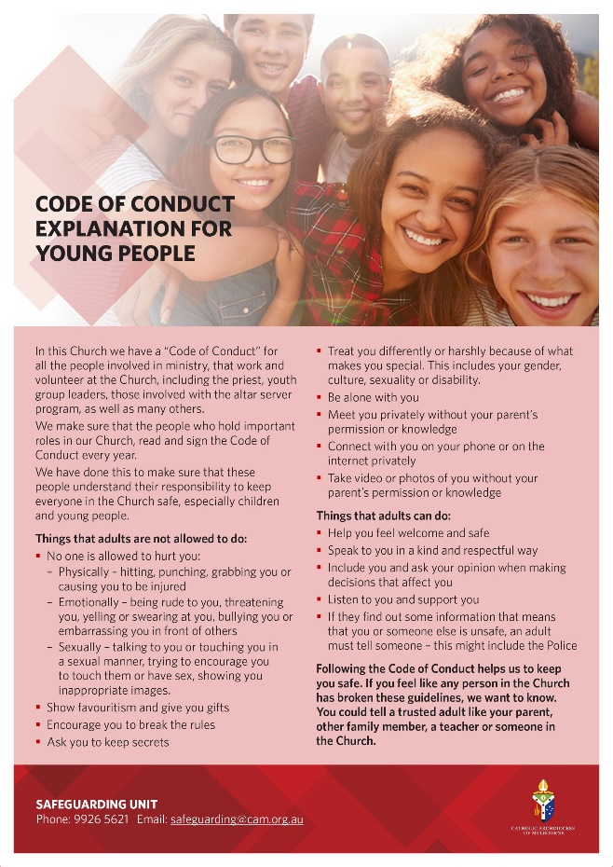
Code of Conduct Explanations
The Code of Conduct has also been explained in child friendly language.
These can be used to explain to children and young people as well as their families, what they can expect from the adults in the parish.

Slide 20
Statement of Commitment
The Statement of Commitment communicates a parish’s shared mission to safeguard children and young people from harm.
It is a public acknowledgement of the parish’s commitment to the protection, wellbeing and safe participation of children and young people.

Slide 21
Responding to and Reporting Abuse

Slide 22
A Message From Pope Francis
‘Looking back to the past, no effort to beg pardon and to seek to repair the harm done will ever be sufficient. Looking ahead to the future, no effort must be spared to create a culture able to prevent such situations from happening, but also to prevent the possibility of their being covered up and perpetuated. The pain of the victims and their families is also our pain, and so it is urgent that we once more reaffirm our commitment to ensure the protection of minors and vulnerable adults.’ Pope Francis, Letter of His Holiness Pope Francis to the People of God, 20 August 2018

Slide 23
Defining Abuse
Abuse is an act, or failure to act which endangers a child or young persons health, well being or development.
It can be a single event or a series of traumatic events.
It is rarely limited to one form of abuse e.g. emotional and physical abuse
Child abuse has immediate as well as life long impacts

Slide 24
Types of Abuse
Emotional/ Psychological Abuse
Physical Abuse
Grooming
Neglect
Spiritual/Cultural Abuse
e.g. When a person uses their power or authority to involve or expose a child to sexual activity. Can occur in person or online, and be perpetrated in a family, organisational or community context
e.g. Failure to provide a child or young person with an adequate standard of nutrition, medical care, clothing, education, shelter or supervision
Family Violence
e.g. Bullying, shaming, threatening language, intentional ignoring and isolating
e.g. Physical punishment, pushing, hitting, shoving, slapping etc.
e.g. A pattern of abusive behaviour which may involve physical, sexual, emotional abuse and/or neglect within a family context.
e.g. A person or a group of people, repeatedly use words or actions to harass someone in person or online (cyber bullying)
Bullying
e.g. Racial or cultural discrimination, the use of spiritual or religious beliefs and practices to control and dominate a person
Sexual Abuse
e.g. Predatory behaviour with the intention of engaging a child in sexual activity. May occur in person, or virtually via mobile phones or social media

Slide 25
Impact of Abuse
The impacts of abuse can change the entire direction of someone's life.
Child abuse and trauma can have far reaching and ongoing impacts that extend into adulthood. Some of those impacts include:
Trauma
Mental health issues including depression and anxiety
Learning difficulties
Drug and alcohol misuse
Post traumatic stress disorder
Aggression and violent behaviour
Cognitive and behavioural issues

Slide 26
Reporting Requirements
All child safety concerns, allegations or complaints must be taken seriously. Too often in the past those reporting child abuse were not believed, their concerns were dismissed, and the interests and status of the alleged perpetrator (or the organisation) were given priority over the victim’s welfare.
Legal action cannot be taken against a person if a report is made in good faith in compliance with expectations set out in the Safeguarding Children & Young People Policy.
It is a requirement of the Safeguarding Children and Young People Policy that clergy, employees and volunteers make a report if they have formed a reasonable belief that a child or young person has experienced abuse, is experiencing abuse or is at risk of harm.
Not reporting child safety concerns, complaints or allegations or preventing, influencing or coercing a person from making a report is a breach of the Safeguarding Children and Young People Policy and may result in disciplinary action and/or possible legal action.

Slide 27
Reporting Requirements
There a few important legislative requirements to be aware of:
Failure to Disclose
Victorian Child Safe Standards & Reportable Conduct Scheme
Failure to Protect
Mandatory Reporting

Slide 28
Reporting Requirements
Failure to Disclose | Failure to Protect
“Reasonable belief” that another adult has committed a sexual offence against a child under the age of 16 years. Failure to report to police can lead to individual criminal charges, the maximum penalty is three years imprisonment. The report must be made to police ASAP | A substantial risk that a child under the age of 16 under the care, supervision or authority of a relevant organisation/entity will become a victim of a sexual offence committed by an adult associated with that organisation/entity. A person in a position of authority in the organisation/entity will be commit this offence if they know of the risk of abuse and have the power or responsibility to reduce or remove the risk, but fail to do so.

Slide 29
Reporting Requirements
Reportable Conduct Scheme | Mandatory Reporting
Requires organisations to respond to allegations of child abuse and other child-related misconduct made against their workers and volunteers. The head of entity i.e Parish Priest must notify Commission for Children and Young People (CCYP) of a reportable allegation within three business days and provide an update within 30 calendar days. Failure to do so is an offence and can result in legal action against the individual. | Certain professionals are legally mandated to report child abuse to statutory authorities if they have formed a belief on reasonable grounds that a child is in need of protection from physical injury or sexual abuse and the child’s parents are unable or unwilling to protect the child. The failure of a mandatory reporter to make a report is considered a criminal offence. As of Feb 2020, ‘people in religious ministry’ were added to the list of mandatory reporters. Within the Catholic Archdiocese of Melbourne, ‘people in religious ministry’ refers to those in ordained ministry (i.e. bishop, priest or deacon).
Notes:
The scheme encompasses 5 types of reportable conduct against, with or in the presence of, a child or young person: sexual offences, sexual misconduct, physical violence, behaviour that causes significant emotional or psychological harm and significant neglect

Slide 30
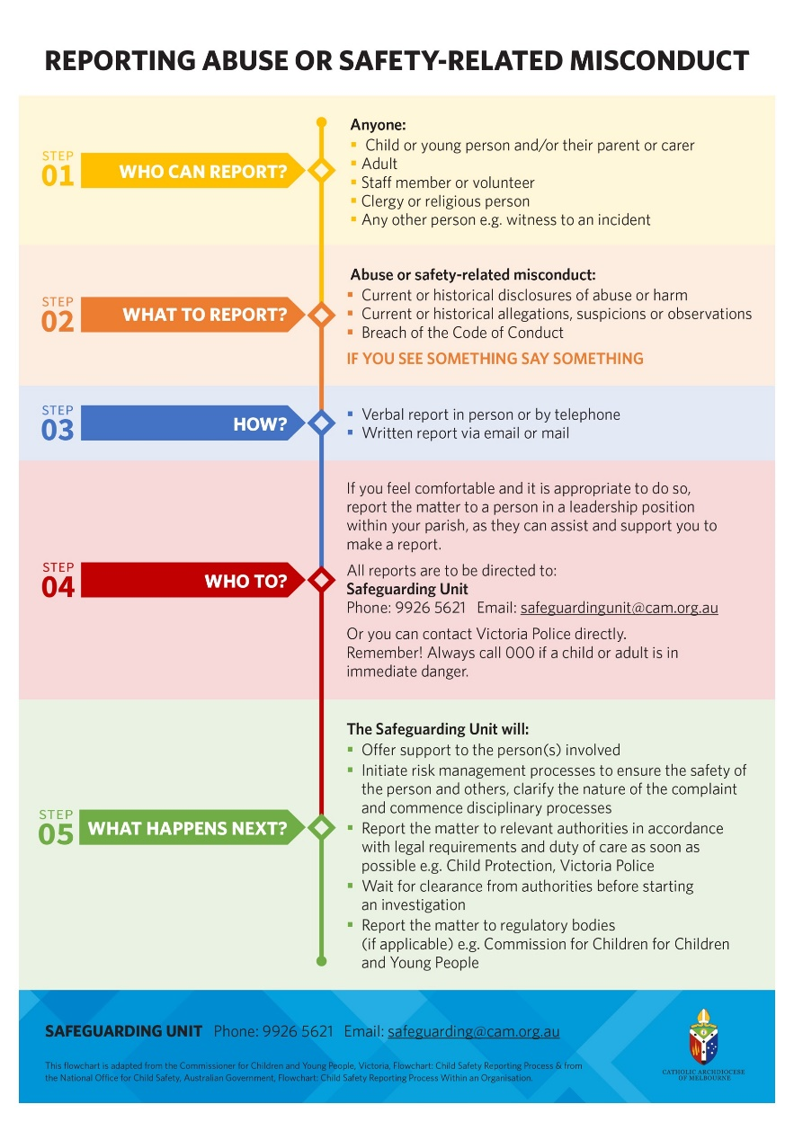
Reporting Requirements
This flowchart outlines the process that must be followed in the event of an allegation of abuse or misconduct
It is important to note that the Safeguarding Unit must be notified of any reports and will support your parish through the process
Notes:
Who to report to:
Child or person in imminent danger = Victoria Police 000
Abuse within a family context = Child Protection (Department of Families, Fairness and Housing)

Slide 31
Who Do We Report To?
Child/ Young Person is in imminent danger
Concerns about Child/ Young Person’s Wellbeing
Child FIRST
Abuse and other child-related misconduct within an organisational context
Victoria Police Sexual Offences &Child Abuse Investigation Teams (SOCIT)
Safeguarding Unit to report to the CCYP Reportable Conduct Scheme
Contact Police on 000
Child Protection

Slide 32
Case Examples
Observations
The young girl is visibly distressed and based on previous interactions this is different to her usual presentation.
Action
We have enough information, and the legal responsibility to make a report to Child Protection and the Police as family violence as well as child abuse is being perpetrated.
A member of the Youth Group is crying and distressed, which is out of character for her.
Case Example
She discloses that she is scared to go home, her dad comes home drunk most nights and physically and verbally assaults her mum. Recently he has started lashing out at her and before Youth Group, he threw her to the floor when she tried to stand up for her mum.
She loves her parents, and does not want to get her family in trouble, so she begs you not to tell anyone.
She just wants a place to stay for a few days, she asks if she can stay at your house.
She has disclosed the abuse that is occurring within her family environment – violence towards her mother, emotional and physical child abuse.
She has been able to provide details of the abuse.
Although she has pleaded not to make a report, it is imperative that the report is made to stop the abuse from occurring and to protect her from further injury and harm. A report to child protection and the police will also allow supports to be put in place for the family.
Part of the role of child protection is to assess if she is safe enough to return home and if not explore other options that will ensure her safety.
Under the CAM code of conduct, allowing her to stay at a volunteers house would be in breach. It blurs the boundaries of the role and also goes against the code of conduct volunteers sign to never be alone with a child.

Slide 33
Case Examples
Observations
There has been a clear change in the presentation of the family
Action
A report to Child FIRST is required as the concern is around the children’s wellbeing as opposed to their safety.
This will allow a number of supports including support for children, mental health support, financial and housing support to be put in place.
The Pastoral Associate has previously provided some support to the mother when she has been in a state of depression, so she thinks that she may be going through another episode. It also comes to light that the father has lost his job and that the family are on the verge of being evicted. It is reported that the children have not been attending school regularly.
A home visit by the Parish Priest and Pastoral Associate is arranged. When they arrive the curtains are drawn and the house is in a terrible state with clothes and rubbish strewn around the house.
The children are inappropriately dressed
You know there has been a history of depression, and suspect this may be occurring again
There is significant strain on the family financially and due to impending eviction
The children are not attending school
The house is in a serious state of neglect
If there were concerns for the children’s safety then a report to child protection would be made.
There are some changes in a family that regularly attends mass. Ordinarily they would attend every week with their two young children however over the last few months they have only come a few times. The children have been inappropriately dressed for the weather dressed in shorts and t-shirts in the middle of winter, and the family are looking a little ‘scruffy’, which is very different to their usual presentation.
Case Example

Slide 34
Case Examples
Observations
Action
Case Example
The Parish Priest is paying particular attention to a new family at the church.
They are a single parent family and are struggling financially.
The Priest is overheard offering to drive the young boy to his after school activities and is witnessed giving the child gifts and money.
Following the mass he is seen alone with the child in the sacristy.
The family could be considered to be vulnerable, so could be a potential target for a perpetrator.
The Priest has singled out this family and is taking a particular interest in them
He is creating situations to be alone with the child
You have formed a reasonable belief that the priest may be grooming the child
Based on these observations, as there is a responsibility to make a report to the Victoria Police SOCIT Team and the Safeguarding Unit.

Slide 35
Defining, Responding and Reporting Abuse
To gain a deeper understanding of defining, responding and reporting abuse please visit the CAM website to view the three e-Learning modules on this topic.
Click on the picture or this link

Slide 36
For Further Information

Slide 37
For more information
A number of useful resources on the CAM website that you can access to support your ministry

Slide 38
Notes:
End

